Slide 1


T-SQL Basics: Coding for performance
Eduardo Pivaral (MCSE, MCSA) – Nov 2020

Slide 2







Thank You to our Global SQLSaturday Sponsors

Slide 3

Thank You to our Local SQLSaturday Sponsors

Slide 4





Eduardo Pivaral
Experience
+15 Years of experience working on IT
+10 Years of experience working with SQL Server
Developer of Open-Source tools for SQL Server administration, development and productivity.
Certifications
SQL Server Database Consultant @ Pythian
Azure Database Administrator Associate
Azure Fundamentals
MCSE Data Management and Analytics
MCSA SQL 2016 Database Development
MCSA SQL 2016 Database Administration
MCSA SQL 2012/2014
www.sqlguatemala.com
Eduardo Pivaral
Community
Regular Author for MSSQLTips.com
Regular Author for SQLServerCentral.com
MSSQLTips.com Rookie of the year 2018
Board member of Guatemala SQL Server User Group
Owner of SQLGuatemala.com
@EduardoDBA
Epivaral

Slide 5
AGENDA
Programming mindset
Proper database design
Indexes and statistics
Demos

Slide 6

Database Programming Mindset
…Code for the future!

Slide 7



Long development life cycles - Lead to releases on old systems
New features could improve existing code - STRING_SPLIT(@st, @separator)
Heavy duty by design – concurrent sessions, high volumes of data
Implement data purging/historical movement processes

Slide 8
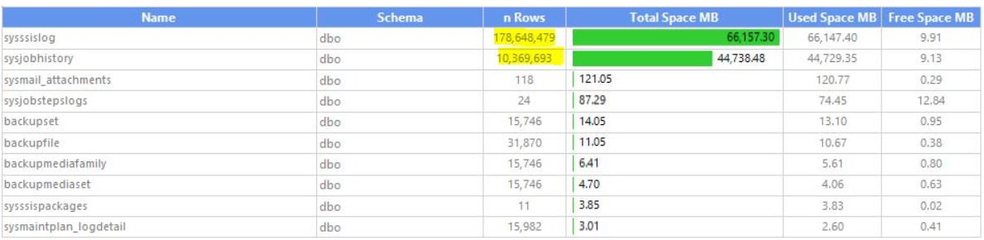
Databases can grow uncontrollably due to message logs and historical data.
http://www.sqlguatemala.com/2017/09/msdb-maintenance-and-cleanup.html

Slide 9
Apply latest patches available on all your development software.
Implement reusable, scalable code – sp_DoSomething(@name);
Comment and format your code: You won’t recognize your own code.
DECLARE @number decimal (9,4) --????
SET @number = (@i + 4.786) / AVG (SELECT factor FROM MyTable WHERE factor > 8.3) --¯\_(ツ)_/¯
Test your code trying to make it fail.
https://www.sqlguatemala.com/2018/02/considerations-for-dealing-with-big.html

Slide 10

Proper Database Design
Fixing issues before they exists

Slide 11
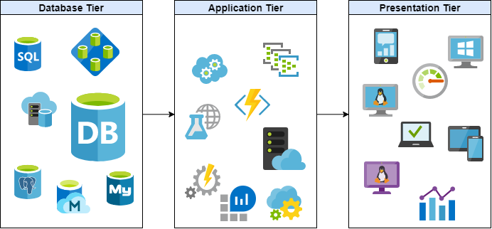
Encapsulate Data operations on database tier
It improves performance and security
Code changes are transparent to application and presentation tier
Minimize Locks by reducing network and IO usage
Migrations are easier without database code on upper tiers

Slide 12
Avoid using SELECT * to send data to client application
By explicitly defining columns, network and disk IO is reduced
Security is improved by sending only required records
ASYNC_NETWORK_IO wait can be avoided
Filter data on the database tier
Data sent to client is reduced even more
SARGABLE: search +‎ argument +‎ -able
Sort data on presentation tier
Sorting is a resource-intensive operation, can negatively impact performance.

Slide 13
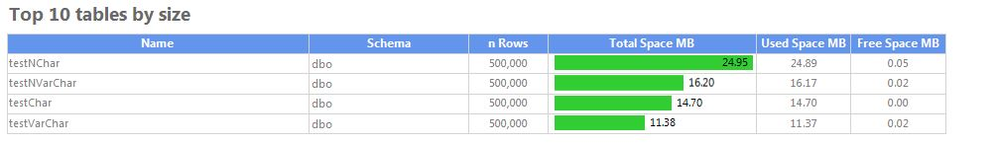
With millions of records, correct datatype make a lot of difference on performance and storage utilization
Wrong datatypes will require data conversions (additional overhead)
Filtering/Joining different datatypes will require implicit conversions (sub-optimal queries)
Comparison between storage used for distinct datatypes storing the exact same data:
Further reading:
https://www.sqlguatemala.com/2018/07/saving-disk-space-by-choosing-correct.html

Slide 14
Indexes and Statistics
Powerful allies if used correctly

Slide 15
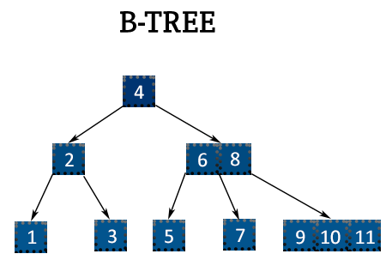
Indexes are special structures associated to tables or views that store information on a B-tree for quick data retrieval
Clustered index: Stores the table ordered by a specific column (usually the primary key).
Non-clustered index: A separate structure that stores the pointer to a row location on the original object, by a specific column.
Performance depends on size, number of columns and datatypes.
Heap: Table without clustered index.
Uses table scans to locate records.

Slide 16
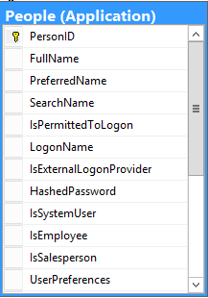
They improve query performance but require additional disk storage and IO.
Limit your index creation.
A good index is when values have a high selectivity (or cardinality)
High Selectivity
Low Selectivity

Slide 17

A Covering index is when index is capable of provide all the data by itself, without accessing pointer to original object.
Can be achieved by using indexed columns or by included columns.
Included columns are not indexed, just are part of the index data
Require extra storage, so use with caution
Further reading:
https://www.sqlguatemala.com/2018/02/performance-basics-key-lookup-operator.html

Slide 18
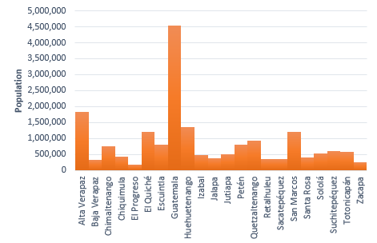

Statistics are used by Query Optimizer to create execution plans based on distribution of required values.
Outdated or non-existent statistics can lead to poor performing queries
Density: Number of unique values in one column.
High density variations on a given column can lead to parameter sniffing issues.
Data with potential parameter sniffing issues
It is possible that departments with less population have less unique last names

Slide 19
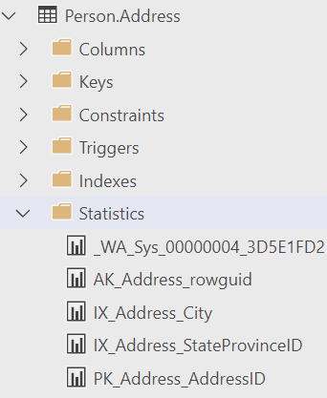
With AUTO_CREATE_STATISTICS enabled, statistics are created by the query optimizer as necessary, with _WA prefix.
Statistics automatically created, are strictly created on single columns.
With AUTO_UPDATE_STATISTICS, they are updated automatically by the engine when column changes reach a threshold*
Updating statistics will cause related queries to recompile.
Use DBCC SHOW_STATISTICS to show statistics information
DBCC SHOW_STATISTICS('Person.Address','IX_Address_city')
* https://docs.microsoft.com/en-us/sql/relational-databases/statistics/statistics?view=sql-server-2017#autoupdatestatistics-option

Slide 20

DEMOS

Slide 21


Please evaluate this session!
Thank you!
Want to know more? Having doubts about this presentation?
Visit me at:
www.SQLGuatemala.com
Eduardo Pivaral
@EduardoDBA
Epivaral
Material available at
https://github.com/Epivaral/Sessions

